Slide 1
Stakeholders Survey First Insights
16.09.2026
TRUSTEE #1 Webinar
Maria Vittoria Gargiulo, ISSNOVA
Notes:
In the next ten minutes I will focus on three points: who is represented in the TRUSTEE Stakeholder Forum, what the preliminary survey is telling us about the ZEWT transition, and how those findings shape the ongoing Stakeholder Forum consultation. The survey is not the final consultation result. It is the PREPARE stage of the engagement process: it gives us an evidence base to decide what needs to be challenged, clarified and stress-tested in the interviews and workshops.

Slide 2

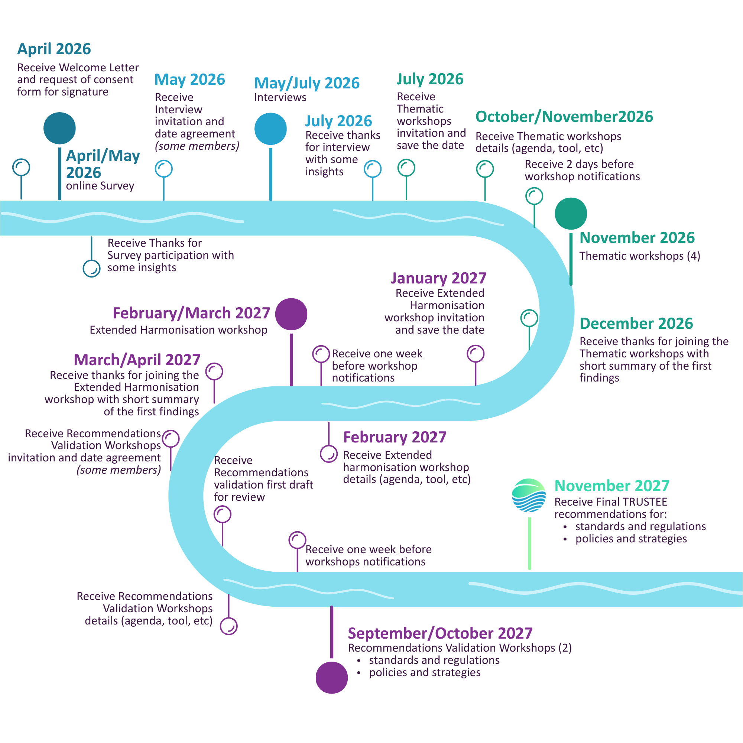
THE SURVEY IS THE START OF THE CONSULTATION
PREPARE
UNDERSTAND
Online survey
Thematic interviews
Initial perceptions before use cases
→
Explain the “why” behind the survey
→
HARMONISE
CONSOLIDATE
Cross-theme validation
Rome thematic workshops
→
Reconcile costs, benefits and risks
Stress-test initial use cases
09/2026
TRUSTEE Stakeholder Survey – highlights
2
Notes:
D3.1 deliberately structures the consultation as a sequence. The survey is the PREPARE step: it captures initial expectations before stakeholders are exposed to the TRUSTEE use cases. The interviews then deepen those results, and the Rome workshops move from opinions to structured assessment of the use cases. This matters for how we read the survey today. We should not ask, ‘What is the final answer?’ We should ask, ‘Where is there convergence, where is there uncertainty, and what must the workshops resolve?’

Slide 3
A FORUM DESIGNED TO COVER THE ZEWT ECOSYSTEM
35
Thematic expertise within the Forum
Stakeholder Forum members
15
10
Strategy & Finance
Technologies & Technical Integration
Organisation mix
12
Public institutions, networks & citizen associations
10
Research organisations
5
5
4
Shipowners & maritime operators
Overall Environmental Impact
Workforce Transition & Wider Societal Impact
4
Waterborne transport business operators
3
Shipbuilding / manufacturing / maintenance
1 + 1
Infrastructure + efficiency/optimisation
Broad European and international reach
Industry • public authorities • operators • research • civil society
Source: TRUSTEE D3.1 Stakeholders Engagement Plan, Sections 2.1–2.4.
09/2026
TRUSTEE Stakeholder Survey – highlights
3
Notes:
The Forum is much broader than the survey sample. It has 35 confirmed members and was deliberately assembled across the ZEWT ecosystem. Twelve members represent public institutions, networks or citizen associations; ten are research organisations; and the remainder bring shipowner, operator, manufacturing, infrastructure and optimisation perspectives. The thematic allocation is also important: fifteen members are in Strategy and Finance, ten in Technologies and Technical Integration, five in Environmental Impact and five in Workforce and Wider Societal Impact. So the November workshops can draw on expertise that is much more balanced than the twenty survey responses alone.

Slide 4
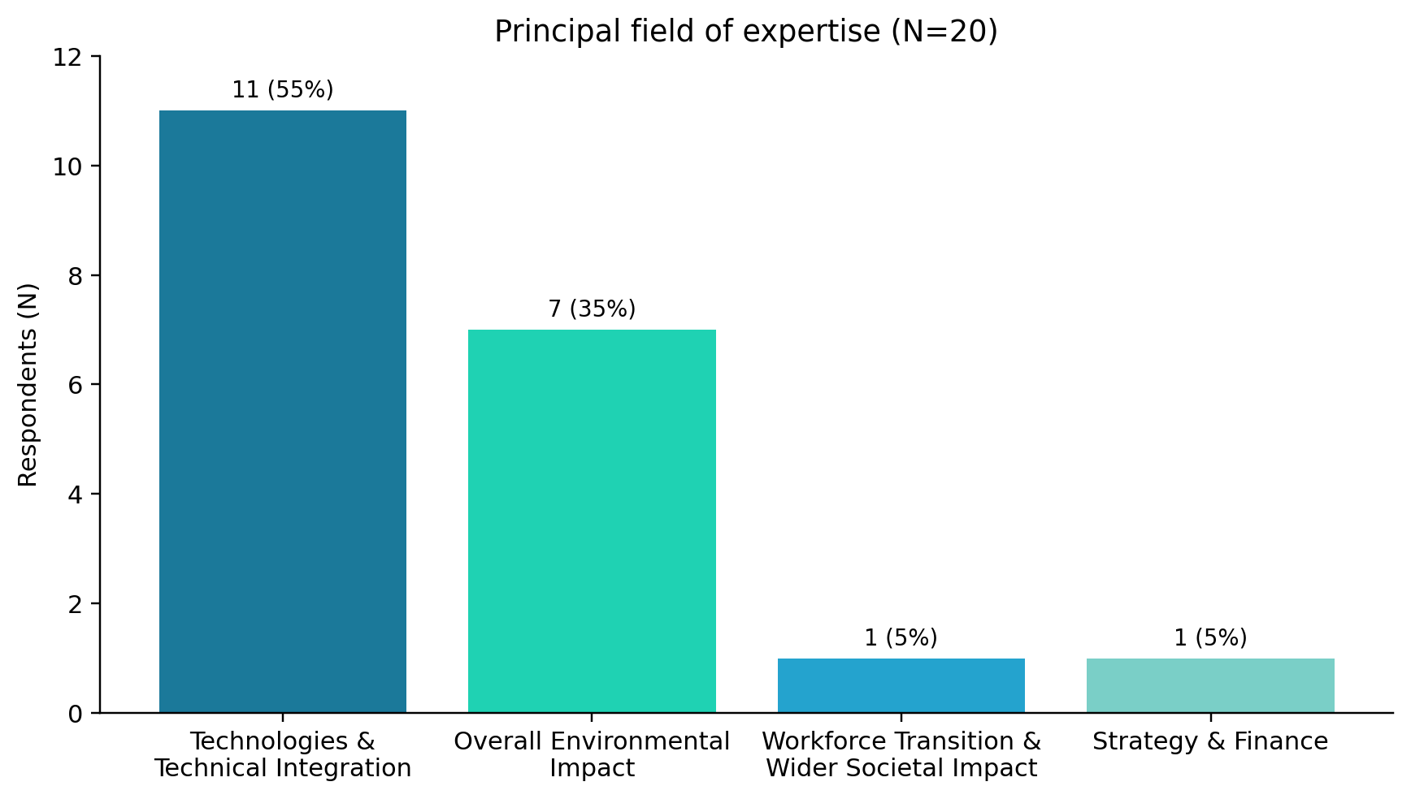
THE SURVEY: 20 EXPERT RESPONSES
20
55%
responses
10+ years
experience
45%
90%
research
institutions
tech + environment
primary expertise
Interpretation rule
Counts + percentages; no statistical claims from tiny subgroups.
Source: TRUSTEE stakeholder survey analysis, clean N=20. Expertise groups shown as principal field of expertise.
09/2026
TRUSTEE Stakeholder Survey – highlights
4
Notes:
We received twenty usable survey submissions and retained all twenty. The sample is experienced: eleven respondents, or 55%, report at least ten years in the sector. But it is not balanced across thematic expertise. Eleven respondents identify primarily with Technologies and Technical Integration and seven with Environmental Impact; only one respondent each identifies primarily with Workforce and with Strategy and Finance. That is why we treat this as targeted consultation evidence, report absolute numbers alongside percentages, and do not infer subgroup differences. The Forum itself will help correct that imbalance in the workshop phase.

Slide 5
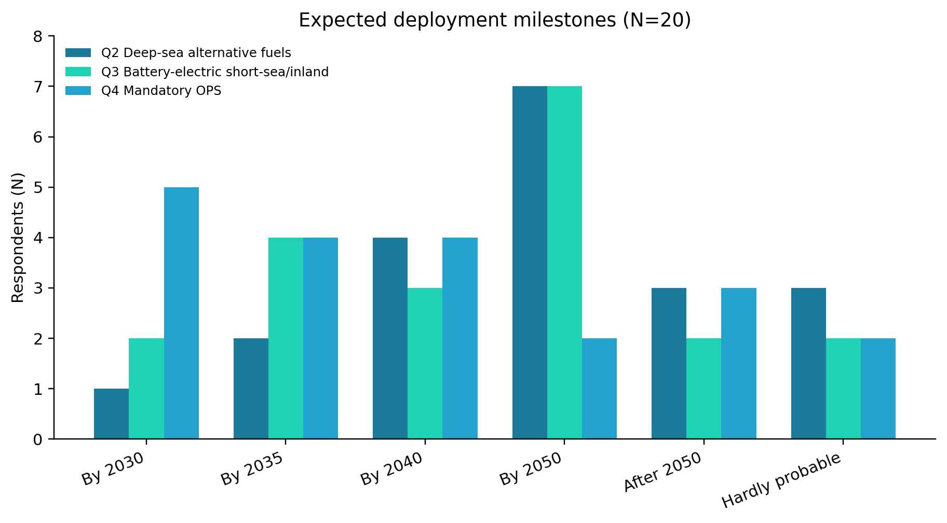
THE TIME-HORIZON
2030
transition / enabling milestone
2050
much stronger confidence in large-scale deployment
By 2050
14/20 deep-sea fuels
16/20 battery short-sea/inland
15/20 mandatory OPS
Source: Q2–Q4, TRUSTEE stakeholder survey (N=20). “By 2050” is a cumulative descriptive summary of explicit milestones.
09/2026
TRUSTEE Stakeholder Survey – highlights
5
Notes:
This is probably the strongest survey signal for the foresight work. Only one of twenty respondents expects large-scale zero-emission fuels in deep-sea shipping by 2030, and only two of twenty expect widespread battery-electric short-sea or inland deployment by then. Confidence rises markedly towards 2050: fourteen of twenty place deep-sea alternative-fuel deployment no later than 2050, sixteen of twenty do so for battery-electric short-sea and inland shipping, and fifteen of twenty for mandatory OPS. The workshop implication is not that 2030 is unimportant. It is that we need to define credible 2030 stepping stones separately from mature 2050 configurations.

Slide 6
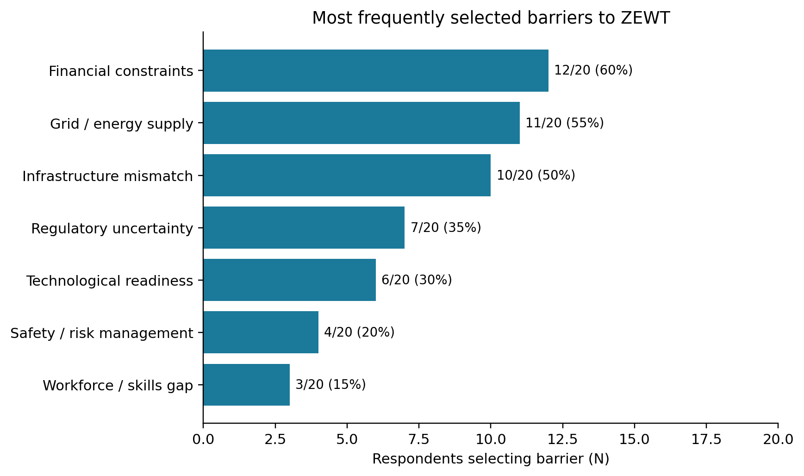
THE TOP BARRIERS ARE NOT “TECHNOLOGY ONLY”
Top three signals
12/20
Financial constraints
11/20
Grid / energy supply
10/20
Infrastructure mismatch
The transition bottleneck is the ecosystem around the vessel.
Source: Q5, multiple-response question. Respondents could select up to three barriers; percentages therefore exceed 100% when summed.
09/2026
TRUSTEE Stakeholder Survey – highlights
6
Notes:
When stakeholders were asked to select their top three barriers, financial constraints came first at twelve of twenty, followed by grid and energy supply at eleven, and infrastructure mismatch at ten. Regulatory uncertainty was selected by seven, and technological readiness by six. This does not mean technology readiness is unimportant; it means that, when forced to prioritise, respondents frequently point to the conditions around technology deployment. For Rome, that tells us to challenge every use case not only on whether the technology works, but on who finances it, where the energy comes from, and whether the required port infrastructure exists on the same timeline.

Slide 7
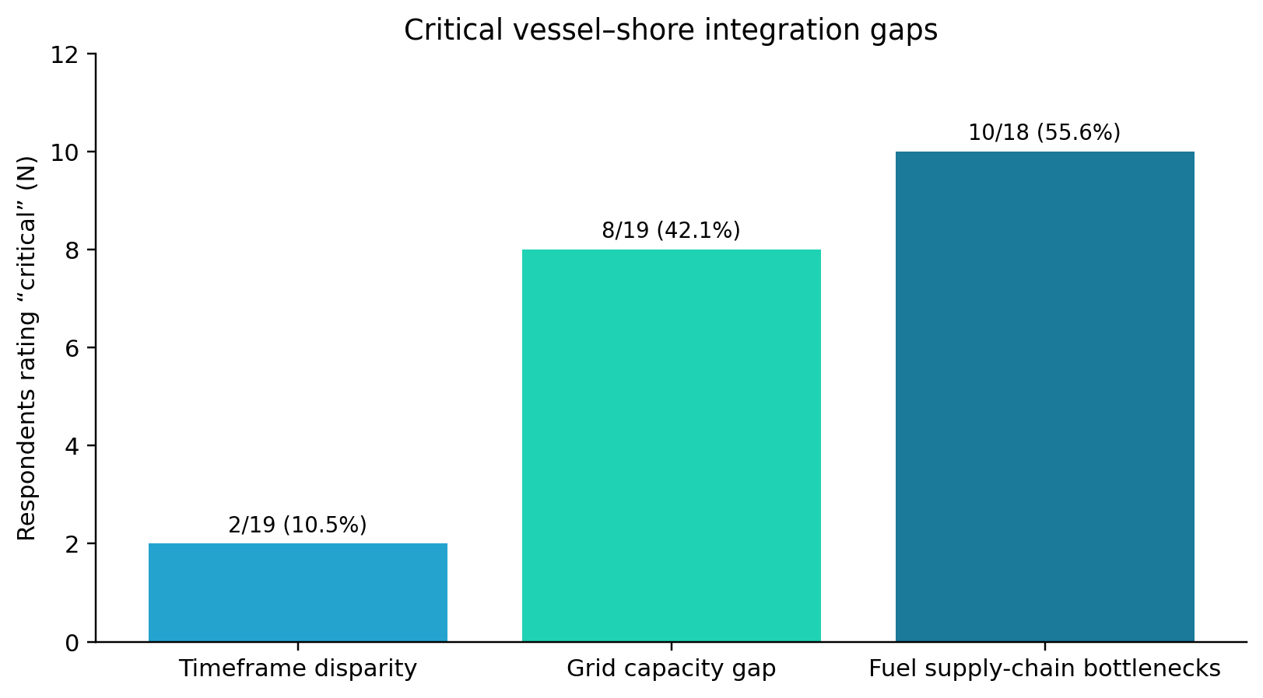
SYSTEM INTEGRATION, REGULATION AND ACCEPTANCE ARE DESIGN CONDITIONS
16/20
14/20
Alternative-fuel bunkering
= deep-sea port priority
Grid / OPS
= deep-sea port priority
15/20
19/20
Agree / totally agree:
risk of two-tier ports
At least partly agree:
community concern over hazardous fuels
14/20
15/20
Rather / absolutely necessary:
standardised port safety rules
At least partly agree:
skills mismatch may bottleneck
Source: Q9–Q12, Q21–Q24. Counts use the valid N for each item; Q9 matrix rows have N=18–19.
09/2026
TRUSTEE Stakeholder Survey – highlights
7
Notes:
The more detailed questions reinforce the same systemic picture. Fuel supply-chain bottlenecks were rated critical by ten of eighteen respondents, and grid-capacity gaps by eight of nineteen. Deep-sea ports are expected to prioritise alternative-fuel bunkering and high-capacity grid or OPS. Beyond infrastructure, fifteen of twenty agree or totally agree that unequal investment capacity could create a two-tier port system. Nineteen of twenty are at least partly concerned that hazardous fuels may generate local community concern. Fourteen of twenty place standardised port safety regulation in the two strongest necessity categories, and fifteen of twenty at least partly agree that skills mismatch may become a bottleneck. These are not add-ons to the technical discussion; they are conditions of feasibility.

Slide 8
THEMATIC WORKSHOPS, FOUR EVIDENCE-DRIVEN QUESTIONS
26 NOVEMBER — AFTERNOON
27 NOVEMBER — MORNING
OVERALL ENVIRONMENTAL IMPACT
TECHNOLOGIES & TECHNICAL INTEGRATION
Which lifecycle boundaries and externalities could reverse an apparently “zero-emission” benefit?
Which vessel-port-fuel configurations are credible in 2030, and which only in 2050?
STRATEGY & FINANCE
WORKFORCE & WIDER SOCIETAL IMPACT
Who pays for ports, grids and fuel supply - and how do we avoid a two-tier transition?
Which skills, certificates, safety measures and local benefits are prerequisites for uptake?
Rome workshops: 26 November 2026 PM — Environmental Impact + Strategy & Finance; 27 November 2026 AM — Technologies + Workforce/Society.
09/2026
TRUSTEE Stakeholder Survey – highlights
8
Notes:
This is how I would translate the survey into the workshop agenda. For Environmental Impact, the survey gives us expectations of meaningful emissions reductions, but lifecycle trade-offs remain uncertain: the workshop should test the boundaries of the environmental assessment. For Strategy and Finance, the dominant question is who bears the infrastructure burden and how we prevent uneven deployment. For Technologies and Integration, we should explicitly separate configurations credible by 2030 from those that require 2050 conditions. And for Workforce and Society, the survey points to skills, certification, safety and community trust as prerequisites that need to be built into the use cases rather than discussed afterwards.

Slide 9
WHAT WE EXPECT FROM THE ROME WORKSHOPS
SURVEY EVIDENCE
USE-CASE PROOF
PRO / CONS / GAPS / SUGGESTIONS
ACTIONABLE INPUT
→
→
→
Strong signals + uncertainty
Both time horizons
Make dependencies explicit
Refine use cases + barriers
Three messages to carry into the room
1
Do not discussing only “Which technology?”
Ask whether the whole ecosystem is ready.
2
Keep 2030 and 2050 analytically separate
2030 = credible stepping stones; 2050 = mature configurations.
3
Treat finance, regulation, skills and acceptance as design variables
Not as downstream implementation issues.
09/2026
TRUSTEE Stakeholder Survey – highlights
9
Notes:
The output we need from Rome is not another list of opinions. The survey has already done the first screening. The workshops should use that evidence to stress-test each initial use case, explicitly for both time horizons, and capture pro, cons, gaps and suggestions in a way that can feed the comparative analysis and barrier work. I would carry three messages into the room. First, ask whether the ecosystem is ready, not only whether the technology is ready. Second, keep 2030 and 2050 separate. Third, treat finance, regulation, skills and acceptance as variables inside the use-case design. That is how the consultation can materially improve the TRUSTEE outputs.

Slide 10
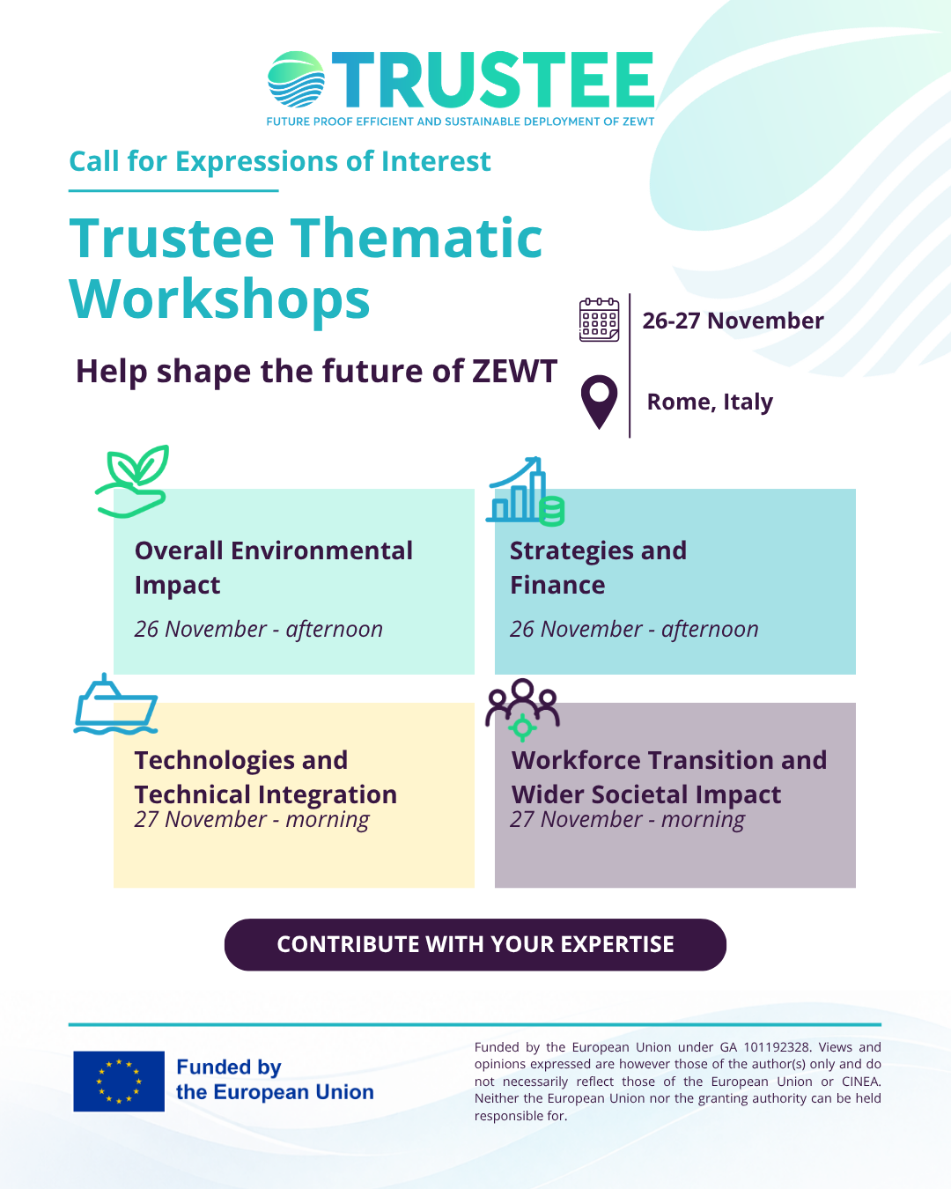
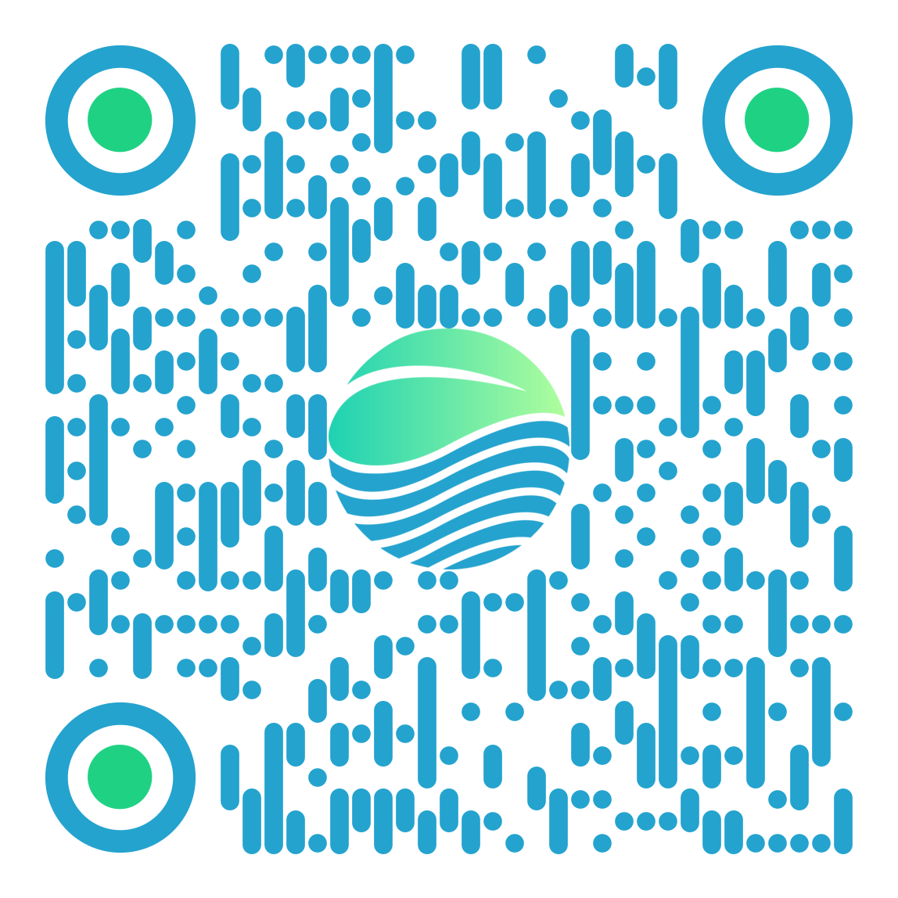
INTERESTED IN CONTRIBUTING TO THE DISCUSSION?
FILL IN THE EXPRESSION OF INTEREST
https://form.jotform.com/262453100214340
GARGIULO@ISSNOVA.EU

Slide 11












THANK YOU!
Maria Vittoria Gargiulo
ISSNOVA
gargiulo@issnova.eu
www.trusteeproject.eu
www.linkedin.com/company/trustee-project
@Project_TRUSTEE @project_trustee
Notes:
The value of the workshops will be in challenging those hypotheses with the broader Stakeholder Forum and turning them into concrete changes to the use cases, barriers and subsequent recommendations.

