Slide 1
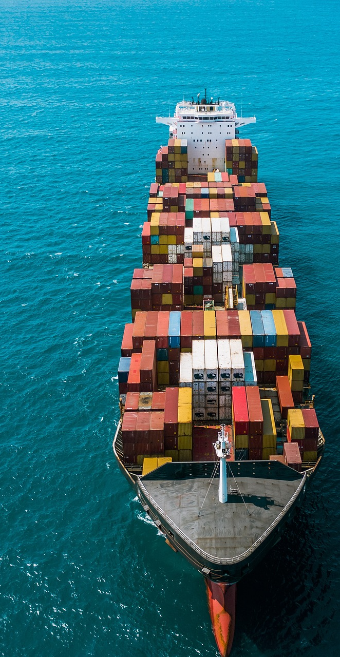


Looking at 2030 and 2050
Discussion of possible transition pathways across the two time horizons, including opportunities, risks and barriers.
This project has received funding from the European Union’s Horizon Europe Program under Grant Agreement 101192328
Notes:
Opening slide. Frame the intervention as a bridge between the initial use-case definition and the comparative technical integration work. Emphasise that the purpose is not to select one universal fuel, but to discuss how different vessel segments can transition across two time horizons: a near-term 2030 phase and a long-term 2050 phase.

Slide 2

What we’ll be talking about today
01
Why 2030 and 2050 describe two different transition regimes
02
How the five TRUSTEE use cases translate into segment-specific pathways
From use cases
to transition pathways
03
Which opportunities can be captured now and which risks must be managed
TRUSTEE
Notes:
Use this slide to set expectations: this is a discussion-oriented contribution, not a final engineering design. The three questions anchor the narrative: the logic of the two time horizons, the segmentation across vessel use cases, and the opportunities and barriers that need stakeholder validation.

Slide 3
The analytical bridge: use cases → pathways
Representative vessel
configuration
Operational scenario
& mission profile
Technology portfolio
& integration logic
Transition pathway
for 2030 / 2050
A harmonised framework makes the five use cases comparable while keeping vessel-specific constraints visible.
Integrated scenario packages
2 mutually exclusive pathways per use case and horizon
Technologies assessed:
Alternative fuels,
Electrification,
Efficiency,
Digital,
Auxiliary systems
5
Vessel use-case families:
• General cargo
• Tanker
• Passenger
• Inland waterways
• Special operations
33
20
TRUSTEE
Notes:
Explain the logic of the TRUSTEE workflow. Each use case is not only a ship type: it combines a reference vessel, an operational scenario and a technology set. This is essential because a technology that works for one segment can be unsuitable for another due to energy demand, port calls, safety zones or retrofit margins.

Slide 4
The analytical bridge: the sources of the analysis
T2.3 – Main information sources for qualitative technology integration
The qualitative baseline combines TRUSTEE technology fiches with external maritime evidence and market data to support 2030/2050 pathway definition.
1. TRUSTEE technology fiches / cards
2. ZEWT EU project evidence
3. Institutional reports and data
• T01–T39 technology cards
• maturity, readiness and applicability
• constraints, dependencies and confidence notes
• European projects developed within ZEWT
• demonstrators and transition scenarios
• fuel, electrification and efficiency learnings
• IMO decarbonisation reports
• EMSA studies and maritime evidence
• policy / regulatory inputs and EMSA database inputs
4. Class & certification evidence
5. Successful use cases & market datasets
• RINA reports and technical guidance
• other certification / class bodies
• safety, design and class-acceptance logic
• deployment examples and successful use cases
• market datasets, including EMSA database
• route, port and adoption constraints
TRUSTEE
Notes:
Explain the logic of the TRUSTEE workflow. Each use case is not only a ship type: it combines a reference vessel, an operational scenario and a technology set. This is essential because a technology that works for one segment can be unsuitable for another due to energy demand, port calls, safety zones or retrofit margins.

Slide 5
The analytical bridge: the overall path for technical qualitative assessment
T2.3 – Methodology adopted for the qualitative integration analysis
The method converts heterogeneous evidence into use-case-specific transition packages, without treating the technology list as a simple ranking.
1. Consolidate evidence base
2. Map to UC requirements
3. Screen integration interfaces
• align fiches with external evidence
• check maturity, applicability and constraints
• document assumptions and confidence
• vessel type, route and mission profile
• energy demand and load pattern
• retrofit or newbuild orientation
• onboard modification needs
• fuel/storage, safety and class interfaces
• port infrastructure requirements
4. Build 2030 / 2050 packages
5. Validate and quantify
• combine compatible technologies
• remove overlaps, conflicts and infeasible options
• distinguish deployability from system change
• define risks, barriers and evidence gaps
• prepare survey validation inputs
• hand over to LCA/LCC and CAPEX/OPEX
Output: coherent transition packages to be validated by stakeholders and quantified through LCA/LCC.
TRUSTEE
Notes:
Explain the logic of the TRUSTEE workflow. Each use case is not only a ship type: it combines a reference vessel, an operational scenario and a technology set. This is essential because a technology that works for one segment can be unsuitable for another due to energy demand, port calls, safety zones or retrofit margins.

Slide 6
Parameters used to project technologies to 2030 and 2050
The projection combines technical feasibility, emission potential and operational-system constraints.
1. Applicability & timing
2. Integration burden
3. Risk interfaces
• applicability to use case
• retrofit vs newbuild orientation
• maturity / readiness
• modularity
• ship modification extent
• port infrastructure need
• technological dependencies
• integration complexity
• affected ship systems
• safety
• certification / class acceptance
• security
• evidence confidence
4. Operational fit
5. Emission axis
• range and endurance
• duty cycle and load profile
• port-call frequency
• energy density / tank volume
• payload and schedule sensitivity
• direct onboard emission-reduction category
• kept separate from feasibility
• WtW to be quantified in LCA
Scenario selection is score-informed, not score-determined: engineering judgement filters compatibility, overlap and real deployment constraints.
TRUSTEE
Notes:
Explain that the 2030/2050 projection is not a simple ranking. The same technology can score differently depending on ship type and time horizon. Emission reduction and feasibility are deliberately kept separate to show trade-offs.

Slide 7
2030 horizon: evolutionary transition
2030 is mainly about making existing and near-term vessels compliant and deployable.
RETROFIT
FIRST
• Fleet inertia: many 2030 ships are already in service
• Drop-in biofuels, LNG or methanol where compatible with engines and routes
• Hybridisation and BESS used where duty cycles and port calls support them
Most relevant 2030 levers
Fuel transition
Efficiency
Electrification
Digital
biofuels • LNG • methanol readiness
coatings • hull cleaning • propulsor optimisation
BESS • hybrid propulsion • shore power
EMS/PMS • voyage optimisation • monitoring
Main opportunity: rapid deployment without waiting for full fleet replacement.
Main barrier: infrastructure, fuel availability and retrofit margins remain route-specific.
TRUSTEE
Notes:
The 2030 horizon should be presented as an evolutionary phase. The priority is not to wait for perfect zero-emission designs, but to reduce emissions quickly on existing assets. This means combining fuels that are deployable in current or adapted engines, efficiency improvements and hybridisation where operational cycles allow it.

Slide 8
2050 horizon: system transformation
2050 assumes climate-neutral operations and mature enabling infrastructure.
NEWBUILD
SYSTEMS
• Alternative energy carriers become integral to vessel architecture
• Ammonia and e-methanol dominate long-range options
• Hydrogen fuel-cell hybrids and battery-electric systems dominate predictable shorter services
Ship design
fuel storage • safety zones • machinery spaces
Port interface
bunkering • high-power charging • grid and fuel logistics
Digital operation
digital twins • real-time optimisation • autonomy support
Regulation & skills
class rules • emergency procedures • crew competence
2050 discussion is therefore a ship–port–energy system question, not only an onboard technology question.
TRUSTEE
Notes:
Move the audience from vessel components to system architecture. In 2050, the key technologies are not plug-in retrofits: ammonia, hydrogen and battery-electric pathways require vessel design, energy supply, port operations, safety rules and workforce capabilities to evolve together.

Slide 9
Technology catalogue assessed in TRUSTEE T2.3
33 technologies were grouped as an integrated portfolio: not only fuels, but also electrification, efficiency, digital systems and ship–port interfaces.
Fuel transition
T01 Biofuels • T02 LNG • T03 e-methanol
Hull, propulsor & wind
T13 coatings/cleaning • T14 propulsor optimisation • T15 ALS • T19 WAPS • T20 azimuth/CPP • T30 towing kites • T39 advanced hull form
Zero-carbon / H₂ pathways
T04 ammonia ICE • T05 H₂ fuel cell • T29 advanced fuel cells • T36 H₂ ICE
Auxiliary / thermal / cargo
T16 WHR • T17 hotel loads • T18 cargo pump/heating • T21 deck machinery • T32 advanced WHR • T33 cryogenic recovery
Electrification
T06 battery-electric • T07 hybrid-electric • T08 BESS • T09 PTO/PTI • T28 swappable batteries
Strategic / enabling options
T26 nuclear • T27 onboard carbon capture • T34 lightweight materials • T35 onboard renewables
Digital / autonomy
T10 EMS/PMS • T11 voyage optimisation • T12 digital twin • T31 autonomous energy management
Each pathway is an architecture: primary energy carrier + efficiency measures + enabling systems + port/interface requirements.
Catalogue logic
TRUSTEE
Notes:
Present the catalogue as a portfolio, not a menu of isolated components. The main point is that the project assesses how technologies combine into feasible pathways, because fuels need enabling systems and efficiency measures to become deployable architectures.

Slide 10
Transition pathway map across the five use cases
Use case
2030 main logic
2050 main logic
UC1 General cargo
Biofuel retrofit / green methanol conversion
Ammonia or e-methanol newbuild
UC2 Tanker
Biofuel retrofit / LNG dual-fuel transition
Ammonia or e-methanol with cargo-safety integration
UC3 Passenger
Hybrid-electric + BESS; battery on short routes
Hydrogen fuel-cell hybrid or battery-electric
UC4 Inland waterway
Battery-electric corridors; hybrid as fallback
Battery-electric or hydrogen hybrid by corridor length
UC5 Special operations
Hybrid-electric + BESS for transients; battery nearshore
Hydrogen hybrid or battery-electric mission vessels
Pattern: deep-sea segments stay fuel-density constrained; predictable short-route services electrify earlier.
TRUSTEE
Notes:
This is the core slide. Explain the segmentation effect. General cargo and tanker vessels are constrained by range and energy density, so 2030 is mainly combustion-compatible and 2050 shifts toward ammonia or e-methanol. Passenger, inland and special-operation vessels have more predictable patterns, port calls or transient loads, allowing earlier electrification.

Slide 11
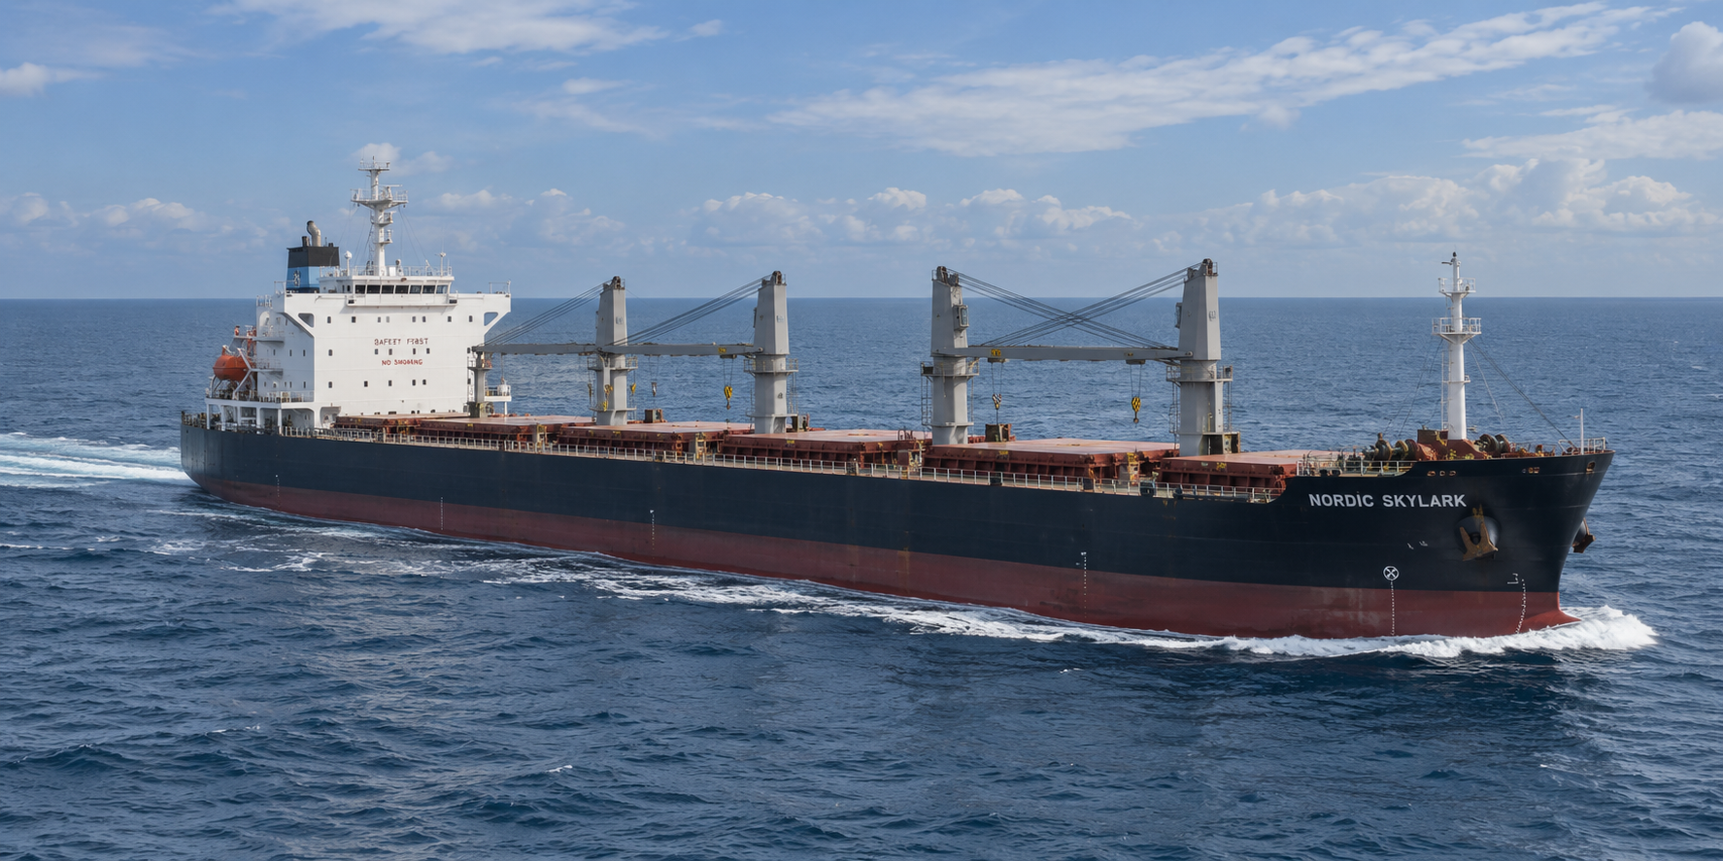
UC1: General cargo vessels
Long-range, propulsion-dominated cargo operations
General cargo is energy-density constrained and has limited opportunities for frequent energy replenishment. The transition therefore moves from retrofit-compatible fuels in 2030 to newbuild fuel-system integration in 2050.
2030 pathway
2050 pathway
Reference vessel
70–80k DWT, 210–230 m
• Drop-in biofuel ICE retrofit
• Green methanol conversion/newbuild where fuel logistics exist
• WAPS, hull friction control, WHR and voyage optimisation
• Ammonia ICE newbuild as reference long-range pathway
• E-methanol newbuild as alternative where supply and safety cases are favourable
• Digital twins and advanced hull optimisation embedded by design
Route profile
1,000–3,000 nm, 3–10 days
Service speed
13–15 knots
Energy driver
Propulsion 85–90%
2030 focus
Retrofit + efficiency
Opportunities, risks and barriers to validate
Certified sustainable-fuel supply • Bunkering availability • Deck and route suitability for wind assistance • Fuel-safety case and crew competence
TRUSTEE
Notes:
UC1 speaker note: emphasise the transition from the 2030 deployable pathway to the 2050 system-level pathway. Stress that the barriers listed are not generic: they derive from the actual operational profile of the use case and will be refined through LCA, LCC and stakeholder validation.

Slide 12
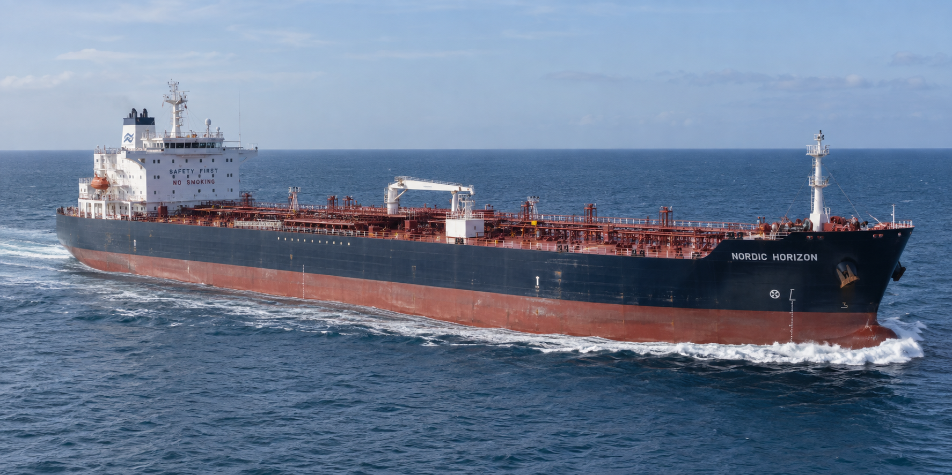
UC2: Tanker ships
Fuel transition under cargo-safety and terminal constraints
Tankers follow a deep-sea combustion logic similar to cargo vessels, but the fuel pathway must be integrated with cargo piping, hazardous zones and simultaneous cargo/fuel operations.
2030 pathway
2050 pathway
Reference vessel
MR class, 40–50k DWT
• Drop-in biofuel ICE retrofit
• LNG dual-fuel as route-dependent transitional option
• Cargo pump/heating optimisation and EMS coordination
• Ammonia ICE newbuild where toxic-fuel segregation is feasible
• E-methanol newbuild as lower-complexity alternative
• Terminal procedures integrated with fuel bunkering strategy
Route profile
800–2,500 nm, 2–7 days
Port calls
Every 5–10 days
Energy driver
Propulsion 70–80% + cargo systems
Specific loads
Pumps, heating, inert gas
Opportunities, risks and barriers to validate
Hazardous-area segregation • Simultaneous operations assessment • Methane-slip control for LNG • Class acceptance and terminal procedures
TRUSTEE
Notes:
UC2 speaker note: emphasise the transition from the 2030 deployable pathway to the 2050 system-level pathway. Stress that the barriers listed are not generic: they derive from the actual operational profile of the use case and will be refined through LCA, LCC and stakeholder validation.

Slide 13
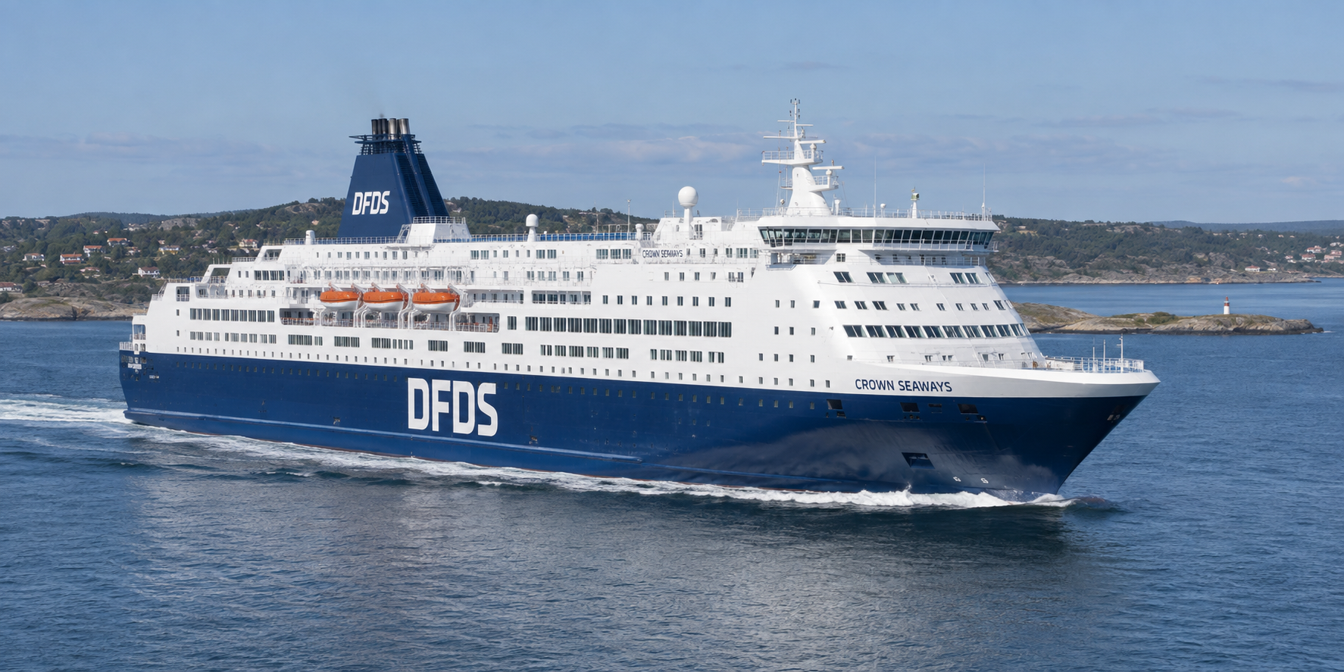
UC3: Passenger ships
Electrification driven by port calls and hotel loads
Passenger vessels move earlier toward electrification because diesel-electric baselines, repeated port calls and high hotel loads make hybrid integration and shore-side interfaces highly relevant.
2030 pathway
2050 pathway
Reference vessel
Ro-Pax / medium cruise
• Hybrid-electric + drop-in biofuel + BESS
• Battery-electric for shorter routes with sufficient charging power
• Shore power and hotel-load optimisation
• Hydrogen fuel-cell hybrid + BESS for longer passenger routes
• Battery-electric where routes and charging windows support it
• Electric-dominant backbone for propulsion and hotel loads
Capacity
800–1,800 passengers
Route profile
100–600 nm, 4–24 h
Port pattern
Daily or multiple daily calls
Energy driver
Hotel load 40–50%
Opportunities, risks and barriers to validate
High-power shore charging and grid capacity • Passenger fire-safety and evacuation • Hotel-load reduction • Public acceptance in sensitive destinations
Use-case descriptions consolidated from D2.1 and T2.3 scenario analysis.
TRUSTEE
13/09/2026
Notes:
UC3 speaker note: emphasise the transition from the 2030 deployable pathway to the 2050 system-level pathway. Stress that the barriers listed are not generic: they derive from the actual operational profile of the use case and will be refined through LCA, LCC and stakeholder validation.

Slide 14
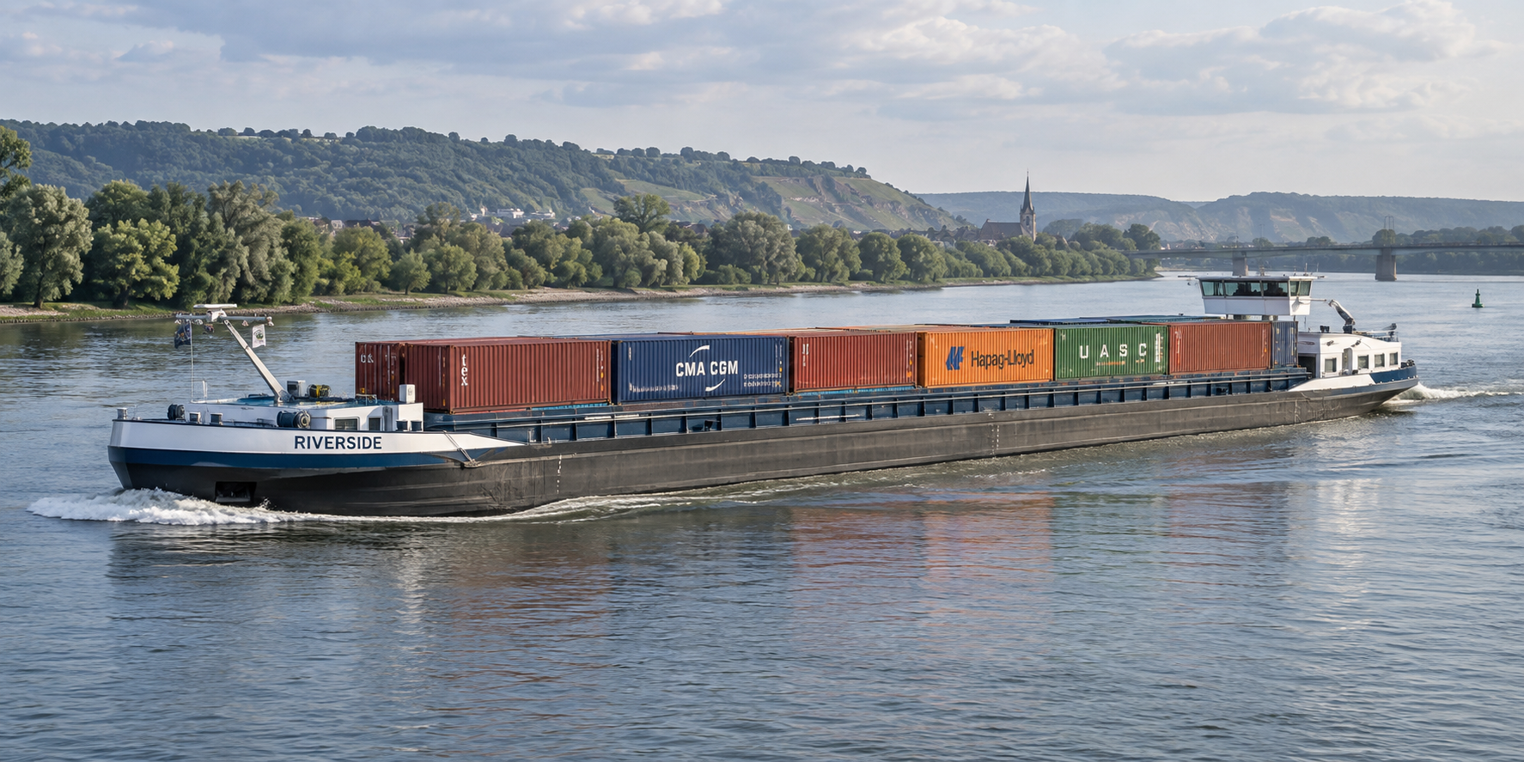
UC4: Inland waterway vessels
Predictable corridors make early battery operation credible
Inland vessels are the strongest case for battery-electric transition because routes, stops and power demand are comparatively predictable. The key uncertainty shifts to charging density and corridor coverage.
2030 pathway
2050 pathway
Reference vessel
80–135 m
• Battery-electric corridor vessel as preferred pathway
• Hybrid-electric + drop-in biofuel where charging is incomplete
• Predictive routing around river currents and lock transits
• Battery-electric where dense charging corridors are available
• Hydrogen fuel-cell hybrid for longer corridors or payload-sensitive cases
• Charging and energy planning fully integrated with terminals
Cargo capacity
1,500–4,000 t / 100–300 TEU
Daily range
20–300 km
Operations
Frequent locks and stops
Energy driver
Stop–go propulsion
Opportunities, risks and barriers to validate
Corridor charging reliability • Grid capacity • Compatibility with port and lock dwell times • Fragmented ownership and financing
TRUSTEE
Notes:
UC4 speaker note: emphasise the transition from the 2030 deployable pathway to the 2050 system-level pathway. Stress that the barriers listed are not generic: they derive from the actual operational profile of the use case and will be refined through LCA, LCC and stakeholder validation.

Slide 15
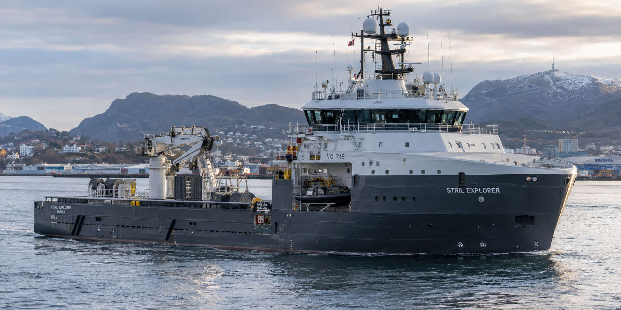
UC5: Special operation vessels
Transient power peaks and nearshore missions
Special-operation vessels are mission-driven units with highly variable load profiles. Decarbonisation is less about long-range endurance and more about power management, peak shaving and zero-emission operation near port.
2030 pathway
2050 pathway
Reference vessel
55–70 m
• Hybrid-electric + BESS + drop-in biofuel for variable duty cycles
• Battery-electric for port and nearshore missions
• Electrified auxiliaries and high-efficiency azimuth thrusters
• Hydrogen fuel-cell hybrid + BESS for endurance beyond battery-only cases
• Battery-electric port/nearshore vessel where duty cycle is validated
• Advanced EMS sized around mission peaks
Installed power
3.0–4.5 MW
Range
50–150 nm from base
Load profile
Standby + transient peaks
Mission loads
Winches, cranes, DP, pumps
Opportunities, risks and barriers to validate
Base-port charging capacity • Duty-cycle validation • Mission peak-power demand • Hydrogen storage and safety for compact vessels
TRUSTEE
Notes:
UC5 speaker note: emphasise the transition from the 2030 deployable pathway to the 2050 system-level pathway. Stress that the barriers listed are not generic: they derive from the actual operational profile of the use case and will be refined through LCA, LCC and stakeholder validation.

Slide 16
Next steps and ongoing work
From technical pathways to quantified, stakeholder-validated transition scenarios.
1
LCA analysis
Quantify Well-to-Wake environmental performance and compare fuel / energy pathways beyond onboard emissions.
2
LCC / CAPEX / OPEX
Give numerical substance to the technical projections by testing investment, fuel, maintenance and operational-cost implications.
3
Survey validation
Bring internal database assumptions under stakeholder review and capture the sentiment of operators across the sector.
4
Scenario refinement
Update packages, barriers and prerequisites before downstream assessment and foresight discussion.
The survey will test whether the technical assumptions derived from internal databases are aligned with real operator priorities, perceived risks and adoption barriers.
TRUSTEE
Notes:
Use this slide as a bridge to the following presentation. Make clear that the present contribution gives the technical structure, while LCA and LCC will add quantitative substance. The survey will validate assumptions and capture operator sentiment, especially on barriers and adoption conditions.

Slide 17
Opportunities: no-regret measures and early wins
No-regret measures reduce the energy requirement that any future fuel system must satisfy.
Advanced EMS / PMS
20/20
Low-friction coatings + hull cleaning
20/20
Propeller / rudder / appendage optimisation
12/20
BESS for load smoothing
10/20
Voyage optimisation
10/20
• Efficiency lowers required tank volume, battery capacity and fuel-cell rating
• Digital optimisation improves operation across all fuels
• Short-route electrification can create visible early ZEWT deployment
Opportunity logic
TRUSTEE
Notes:
Present this as the positive agenda. Regardless of the primary fuel, energy demand reduction matters. Hull friction control, propulsor optimisation, EMS/PMS and route optimisation are robust because they make every future propulsion pathway smaller, cheaper and easier to integrate.

Slide 18
Risks and barriers: why high potential is not enough
The central paradox: near-zero onboard pathways often carry the strongest implementation burdens.
Infrastructure
green-fuel bunkering
high-power charging
local grid capacity
Safety & class
toxic / low-flashpoint fuels
segregation and detection
emergency procedures
Operations
turnaround schedules
route endurance
payload and tank volume
Workforce & market
crew competence
CAPEX/OPEX exposure
fuel-price uncertainty
Decision implication
Assess technologies as integrated ship–port–energy systems, not as isolated onboard components.
TRUSTEE
Notes:
Use this slide to avoid techno-optimism. Component readiness does not equal route deployability. Ammonia and hydrogen need safety cases, bunkering and crew training; batteries need charging power and grid capacity. These external interfaces can change the practical ranking of technologies.

Slide 19
Questions for the stakeholder discussion
The pathways are a structured basis for discussion, not a final ranking.
1
Where can 2030 deployment be accelerated?
Which retrofit-compatible measures are already bankable and route-ready?
2
Which infrastructure choices unlock 2050 pathways?
Where should green-fuel bunkering, charging and grid capacity be prioritised?
3
What risks need early governance?
Safety certification, crew competence, fuel supply and stakeholder acceptance.
Expected output: validate assumptions, identify barriers and refine the transition packages for the next WP2 analyses.
TRUSTEE
Notes:
Close the substantive part by inviting feedback. The key is to validate assumptions, especially where they depend on real route conditions, port capabilities, fuel supply and operating economics. This also links directly to the next analytical tasks in WP2.

Slide 20
Takeaways
No single pathway
Technology choice depends on vessel segment, route, duty cycle and port access.
2030 = deployability
Retrofit-compatible fuels, hybridisation and efficiency can move quickly.
2050 = integration
Near-zero pathways require mature ship–port–energy ecosystems.
No-regret measures matter
EMS/PMS, hull-friction control and optimisation reduce demand across all pathways.
Thank you
TRUSTEE • Future proof efficient and sustainable deployment of ZEWT
TRUSTEE
Notes:
Final recap: one fuel cannot solve the whole fleet; 2030 is about credible deployment and 2050 about systemic transformation. The audience should leave with the idea that TRUSTEE is building a comparable but segment-sensitive framework for decarbonisation pathways.

