Slide 1
Project at a glance
Gabriella DUCA, ISSNOVA
Project Coordinator

Slide 2










The project
Coordination and Support Action
  funded under the call topic HORIZON-CL5-2024-D5-01-16 - Structuring the Waterborne transport sector, including through changed business and industrial models in order to achieve commercial zero-emission waterborne transport (ZEWT Partnership)
Budget
  € 849 999,38
Duration
  1 February 2025-31 January 2028
Consortium
Project coordinator

Slide 3
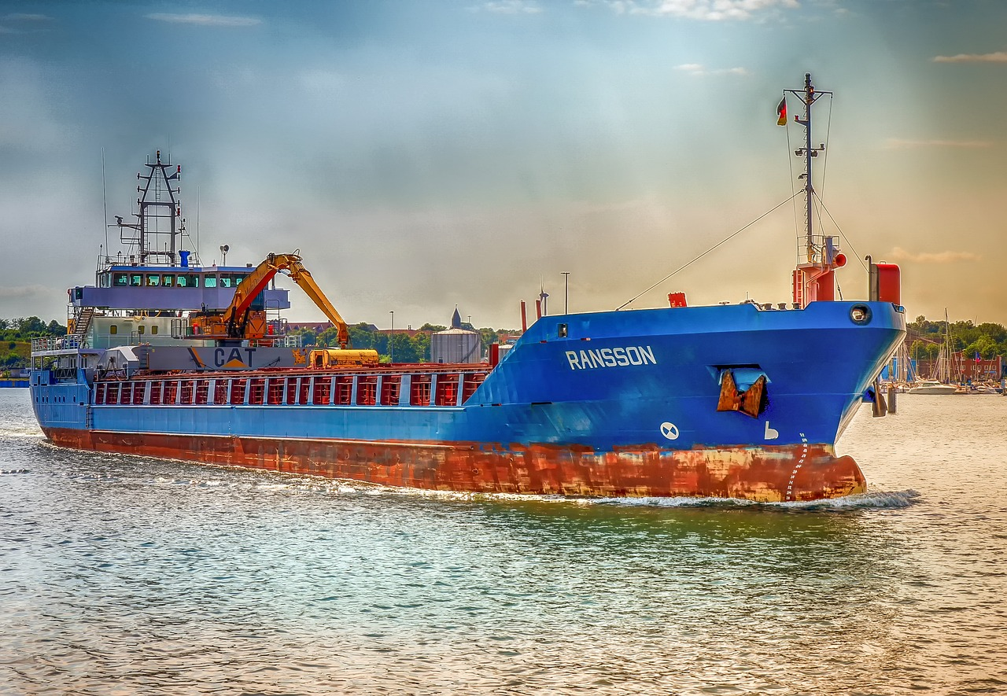
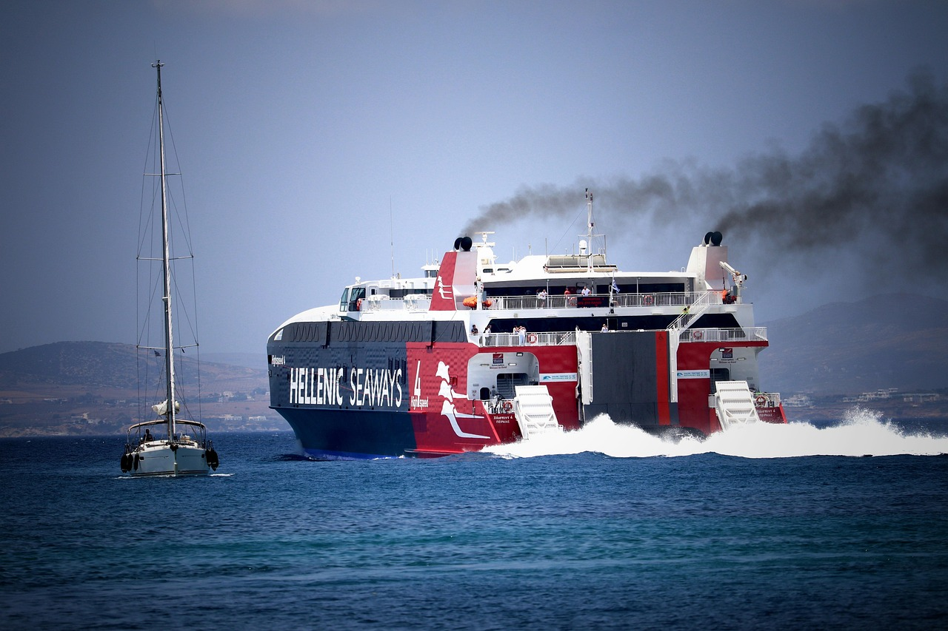
TRUSTEE Objectives
  develop foresight scenarios to explore possible development pathways for European ZEWT ecosystem for 2030 and 2050
  identify the most promising ZEWT use cases for the 2030 and 2050 target years
  develop a multi‑stakeholder assessment framework covering the overall ecosystem that supports zero‑emission goals in European water transport,
  analyse barriers that hinder ZEWT targets and formulate practical recommendations to enable their timely roll‑out
  build a shared knowledge base among all relevant direct and indirect stakeholders

Slide 4
Exploitable results
ZEWT 2030 and 2050 foresight scenarios
ZEWT technology readiness review
ZEWT barrier analysis
Comparative analysis framework for ZEWT use cases assessment
Most promising ZEWT Use Cases
Recommendations for ZEWT deployment
ZEWT open access learning pack

Slide 5










THANK YOU!
Gabriella DUCA, ISSNOVA
duca@issnova.eu
www.trusteeproject.eu
www.linkedin.com/company/trustee-project
@Project_TRUSTEE @project_trustee

