Slide 1


SETTING THE SCENE
Fleet Transformation
and Key Trends
towards ZEWT
TRUSTEE webinar | 16 September 2026
Patrizio Di Francesco | RINA
Notes:
Today I will set the scene for the fleet transformation: what is changing in the fleet, which trends are already visible, and why the pathway to zero emissions is a system transition rather than a single-fuel choice.
The maritime transition is already visible, but it will not follow a single universal path. It will require a coordinated transformation of ships, fuels, infrastructure, operations, regulation, and skills.

Slide 2
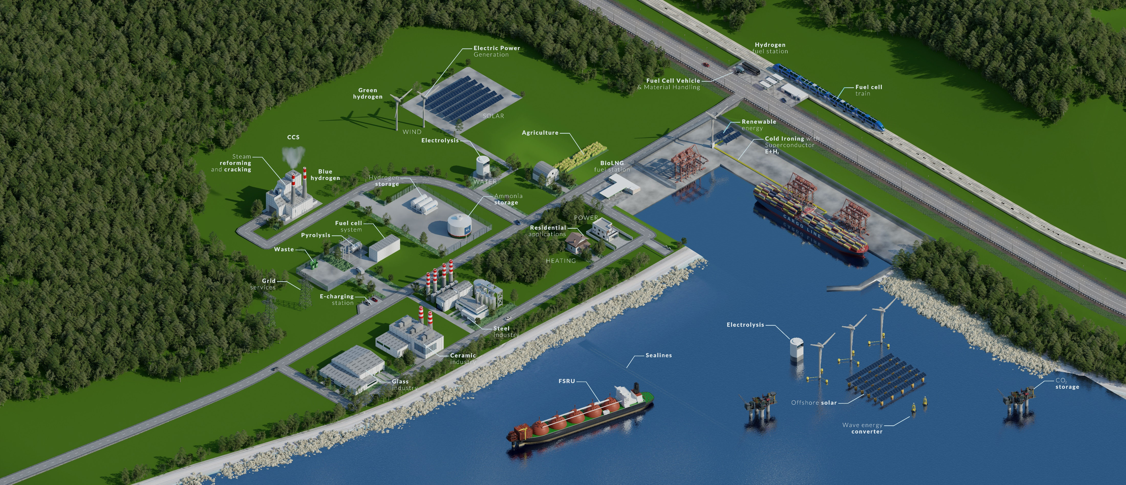
ZEWT is a fleet-and-ecosystem transformation
The shift is broader than replacing one fuel with another.
1
FLEET
Newbuild specifications + retrofit decisions
2
ENERGY
Fuels, converters, storage + efficiency
3
PORTS
Bunkering, shore power + supply chains
4
OPERATIONS
Routing, energy management + digital services
5
PEOPLE & RULES
Safety, skills, acceptance + regulation
Notes:
The core message is that ZEWT is not only a propulsion transition. It links fleet renewal and retrofits to energy supply, ports, operations, digitalisation, regulation and workforce readiness. A bottleneck in any one layer can slow deployment.
The second fundamental idea is that ZEWT does not simply mean replacing diesel with ammonia, hydrogen, or methanol.
The transition simultaneously involves:
fleet, i.e. newbuilds and retrofits;
energy, i.e. fuels, batteries, fuel cells, and efficiency;
ports, i.e. bunkering, shore power, and supply chain;
operations, i.e. energy and voyage optimisation;
people and rules, i.e. safety, training, acceptance, and regulation.

Slide 3
The starting point: scale, diversity and long asset lives
A single pathway cannot fit every vessel segment and operational profile.
~20%
Deep sea
Passenger
Container · bulk · tanker
Cruise · ferry · RoPax
of the global merchant fleet is European-controlled, measured by gross tonnage or vessel numbers.
Specialised
Inland
Offshore · service vessels
Short routes · constrained infrastructure
Implication: prioritise the best-fit combination of retrofit, newbuild, fuel and efficiency measures by segment.
Notes:
Europe starts from a large and highly diversified fleet. Vessel size, route length, duty cycle, port calls and remaining economic life all change the feasible solution. Therefore the transition will be portfolio-based, not uniform.

Slide 4
The orderbook already signals a transition
RINA-controlled 2025 backlog analysed in TRUSTEE D1.2: 1,012 vessels.
Explicit alternative fuel / fuel-ready
38.5%
LNG-related
27%
Methanol-related
17.5%
Ammonia-ready / combined
7.5%
Battery-hybrid / equipped
6.5%
Readiness-oriented design is becoming a hedge against fuel, infrastructure and regulatory uncertainty.
Notes:
The 2025 backlog provides a concrete market signal. More than a third specifies an alternative-fuel or fuel-readiness solution. LNG is the largest pathway, methanol is clearly visible, ammonia-ready designs are emerging, and batteries are concentrated in operational profiles where hybridisation creates immediate value. The percentages overlap by design, so they should not be added together.
The RINA 2025 backlog analysed in D1.2 comprises 1,012 ships. About 38.5% explicitly specify an alternative-fuel or fuel-ready solution. The backlog also features LNG-related solutions at around 27%, methanol-related at around 17.5%, ammonia-ready or combined at around 7.5%, and battery-hybrid or battery-equipped at around 6.5%. The categories may overlap and therefore must not be added together.
The key point is not that one fuel has already prevailed over the others, but that shipowners are increasingly choosing solutions capable of ensuring strategic flexibility.

Slide 5
Three levers will transform the fleet
The fastest progress comes from combining them, not choosing only one.
1. Retrofit the fleet
2. Build for optionality
3. Optimise operations
• Energy-efficiency devices
• Hybridisation and energy storage
• Fuel-ready conversions
• Digital optimisation
Best suited where remaining vessel life and operational profile support the investment.
• Flexible machinery layouts
• Space and segregation provisions
• Future fuel tank integration
• Modular electrical architecture
Readiness reduces the risk of locking a new vessel into one uncertain pathway.
• Peak shaving and EMS
• Voyage and speed optimisation
• Port-area zero-emission operation
• Infrastructure-aware deployment
Operational measures can support near-term reductions while technology scales.
Notes:
Fleet transformation works through three levers: retrofit suitable existing assets, design new ships for optionality, and optimise operations. Hybridisation, for example, is already most attractive in specialised and short-sea profiles with frequent port calls, high hotel loads or dynamic positioning.
The fleet will be transformed through three levers.
Retrofit: Suited to ships for which remaining lifespan, configuration, and operating profile justify the investment.
Newbuild optionality: New ships must avoid the risk of becoming locked into a single, still-uncertain energy solution.
Operational optimisation: Operational and digital measures can reduce consumption and emissions while fuels and infrastructure reach wider adoption.

Slide 6
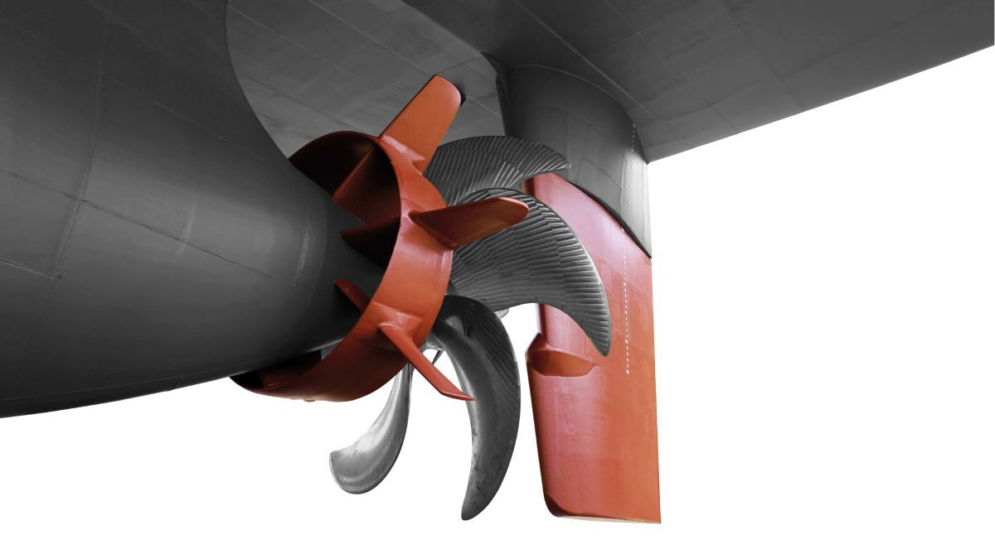
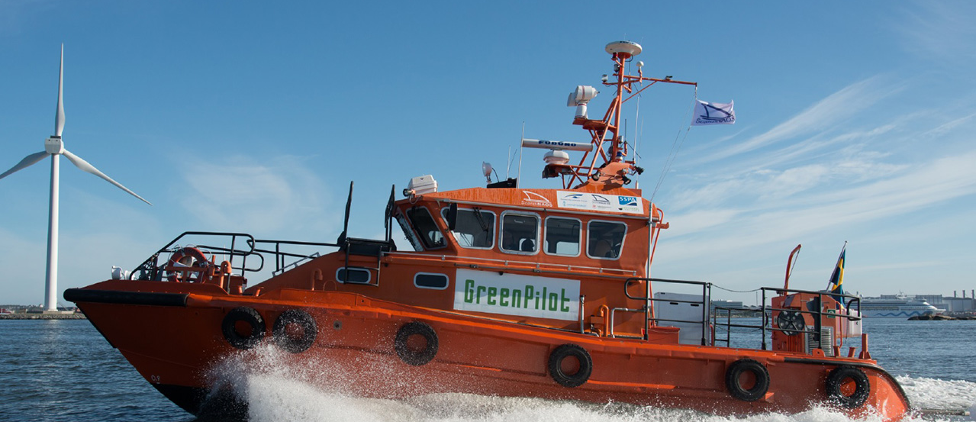
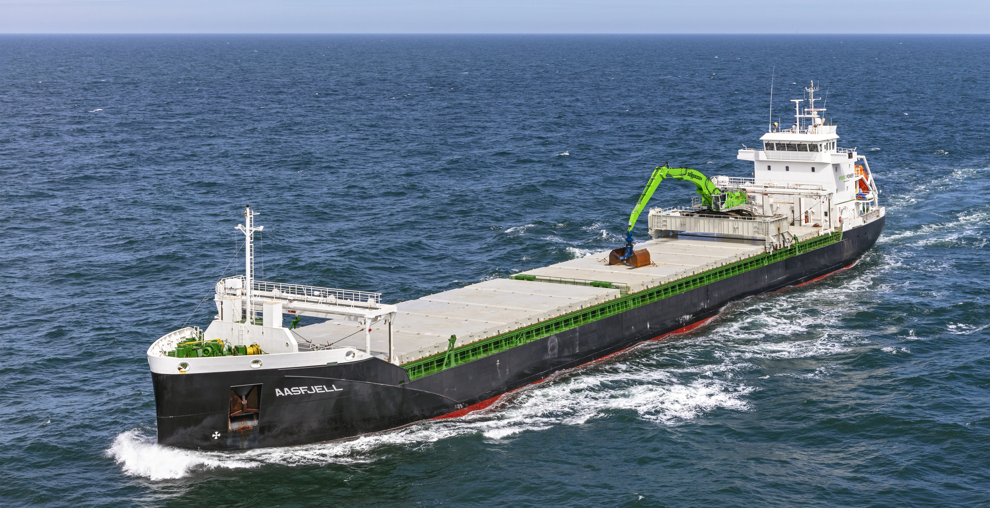
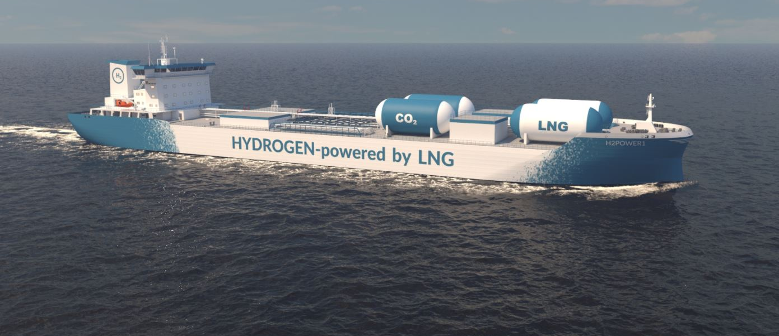
Key trends: a portfolio, not a winner-takes-all race
Near-term deployability and long-term transformation must be managed together.
DEPLOY NOW
Efficiency devices, optimisation, selected biofuels
Reduce energy demand and use available pathways
SCALE NEXT
Methanol, batteries and hybrid systems
Build infrastructure and repeatable business cases
DESIGN FOR
Hydrogen, ammonia and advanced fuel cells
Reserve space, manage safety and mature supply chains
Notes:
The technology trend is a portfolio. Mature efficiency and operational measures can act now. Methanol and hybrid systems are closer to broad commercial deployment. Hydrogen and ammonia retain strong transformational potential, but need continued work on safety, storage, infrastructure and supply chains. The right sequence depends on use case.
The future fleet will use a portfolio of solutions.
DEPLOY NOW
"Efficiency devices, optimisation, selected biofuels." This first tier gathers the solutions that can already contribute today to reducing consumption and emissions.
Efficiency devices include, for example, propeller and bulb optimisation, wind-assisted propulsion, air lubrication, and measures to improve hull and propulsion efficiency. Operational optimisation is understood as the optimisation of the voyage, speed, and onboard energy management. And finally, selected biofuels, meaning those for which availability, sustainability, and performance across the entire life cycle have been verified.
SCALE NEXT
The second tier comprises technologies that are already present on the market or in the orderbook, but that need to be brought to a larger scale. These technologies are not merely experimental concepts, but to achieve a significant impact across the entire fleet it is necessary to increase the availability of the solutions, develop infrastructure and supply chains, make projects replicable, consolidate the business cases, and extend the application to compatible segments.
DESIGN FOR
This tier includes technologies with considerable decarbonisation potential, but for which widespread adoption still requires progress. The aspects to be developed include: sustainable production at adequate scale, availability in ports, bunkering, onboard storage, safety requirements, ship integration, regulation, crew training, and economic sustainability.

Slide 7
What will determine the pace of fleet transformation?
Five conditions must move together.
1
2
3
4
5
Clear, stable regulation
Affordable low-GHG energy
Port and bunkering infrastructure
Bankable fleet investments
Skills, safety and acceptance
The transition is already visible. The strategic challenge is to synchronise technology, fleet renewal, infrastructure and people.
This is the starting point for choosing credible pathways to 2030 and 2050.
Notes:
To close, the fleet transition is not waiting for a single perfect technology. It is already visible in orderbook choices, retrofit strategies and hybrid applications. The pace will depend on synchronising regulation, energy availability, infrastructure, finance, and skills. This sets the scene for the next discussion on pathways to 2030 and 2050.
The transition is already under way. The strategic challenge no longer consists in identifying a single perfect technology, but in coordinating fleet renewal, retrofit measures, energy supply, infrastructure, regulation, and skills. This represents the starting point for the next discussion on realistic pathways towards the 2030 and 2050 targets.

Slide 8







Thank you for your attention
Patrizio Di Francesco, RINA
TRUSTEE webinar | 16 September 2026
www.trusteeproject.eu
www.linkedin.com/company/trustee-project
@Project_TRUSTEE @project_trustee

